Slide 1
Florida Mathematics Re-Design Resource Package
July 31, 2019 & September 6, 2019
#FLStudentSuccess

Slide 2
Webinar Logistics

Slide 3
Agenda
The Why
Continued Support from the Florida Student Success Center
Potential Audience(s)
Resource Package Content
Master Slide Deck Content
The Importance of Math Pathways & Re-Design
Introduction of Florida Student Success Center
Workgroups
The Process of Math Re-Design
Types of Recommendations
Construction of Recommendations
Key Themes
Moving Forward
Feedback
Feedback on Recommendations Survey Results

Slide 4
The Why

Slide 5
Why Share the Recommendations?
Students are the driving force behind the work we do and math is an evident hurdle to student success:
“Gateway and developmental mathematics courses pose the most significant academic barrier to postsecondary attainment for millions of students each year, especially those from underrepresented or non-traditional groups of college students” (AMPSS, 2017, p. 2).
Florida’s public education system collectively provides students college access (i.e. dual enrollment, statewide 2+2 articulation agreement, etc.), therefore a collaborative approach between school districts and postsecondary systems is vital to math re-design and student success
Our goal is to create policies and practices and identify ways to create mathematics pathways, while providing support to institutions to develop scalable and sustainable mathematics practices that improve mathematics success for students across all educational systems

Slide 6
Why Share the Recommendations? Cont.
The intent of the workgroup recommendations is to provide a launching point to impact real, transformative change that increases student success in mathematics
To affect statewide change, institutional and state representatives will need to collaborate to impact both state and local policy supporting mathematics pathways reform
There is work that can be done at the local level now to move the needle
It will be up to those involved in this initiative to be local champions for change by engaging the appropriate stakeholders in this work

Slide 7
Continued Support from the Florida Student Success Center

Slide 8
Continued Support from the Florida Student Success Center
The center will continue the mathematics reform work and move the recommendations forward by:
Conducting a public comment period to solicit feedback on the recommendations from July-October 2019
Creating a steering committee with equal representation from K-12, the Florida College System and the State University System to lead the implementation of the recommendations
Continuing the periodic release of publications discussing mathematics education in Florida
Establishing the Florida Pathways Institute to help Florida College System institutions implement guided pathways, of which mathematics re-design is a critical component

Slide 9
Potential Audience(s)

Slide 10
Potential Audience(s)
Math faculty
Non-math faculty
Advising departments
Department chairs
College presidents
District school boards

Slide 11
Resource Package Content

Slide 12
Resource Package Content
“How-to” document for sharing and collecting feedback on recommendations
Master slide deck
Handout
At-a-glance version of recommendations publication

Slide 13
Resource Package “How-To”

Slide 14
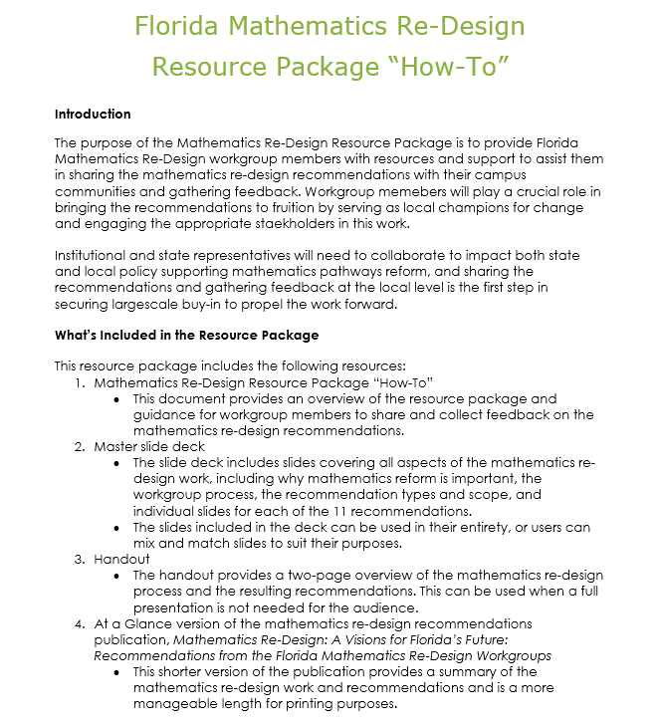
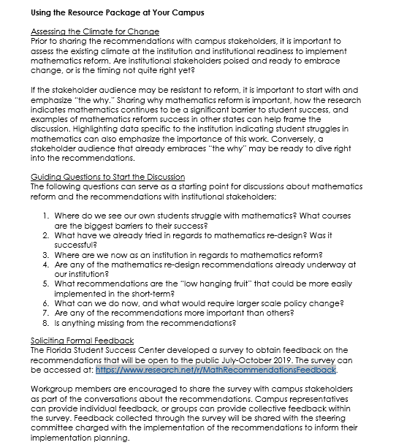
Resource Package “How-To”

Slide 15
Master Slide Deck

Slide 16
The Importance of Math Pathways & Re-Design

Slide 17
Introduction of Florida Student Success Center (FSSC)

Slide 18
Workgroups

Slide 19
The Process of Math Re-Design

Slide 20
Types of Recommendations

Slide 21
Construction of Recommendations

Slide 22
Key Themes

Slide 23
Recommendations

Slide 24
Moving Forward

Slide 25
Feedback

Slide 26
At A Glance Document

Slide 27
At a Glance Document

Slide 28
Feedback on Recommendations Survey Results

Slide 29
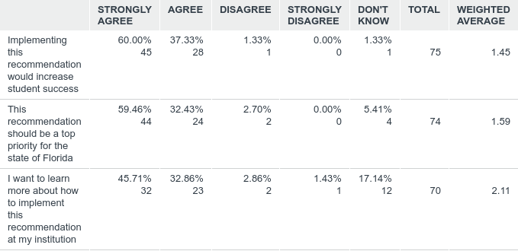
Q1: Recommendation 1: Create common mathematics pathways by aligning mathematics courses to programs, meta-majors and careers in Florida.

Slide 30
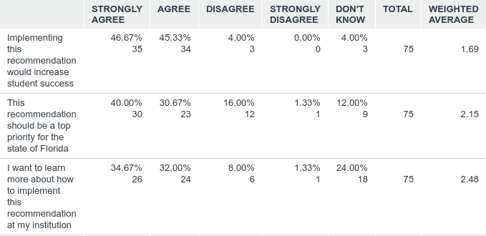
Q2: Recommendation 2: Use a “multiple measures” model to help improve placement, especially in mathematics.

Slide 31
Q3: Recommendation 3: Ensure mathematics prerequisites align with mathematics pathways.

Slide 32
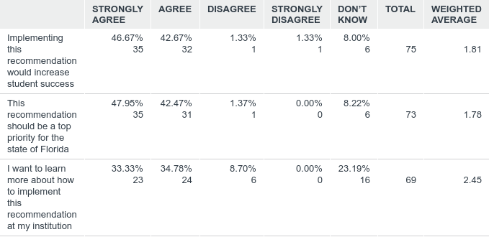
Q4: Recommendation 4: Revise the statewide learning outcomes for developmental and gateway mathematics courses and identify essential mathematical processes.

Slide 33
Q5: Recommendation 5: Encourage colleges and universities to implement instructional models (such as the co-requisite model) that place students, when appropriate, directly into college-level mathematics courses carrying general education credit.

Slide 34
Q6: Recommendation 6: Create recurring opportunities for K-20 stakeholders to promote collaboration to strengthen mathematics pathways for students via standing advisory groups/working groups and “big meetings.”

Slide 35
Q7: Recommendation 7: Determine the K-12 standards that align with the postsecondary courses identified for each major or meta-major to inform student course selection in high school.

Slide 36
Q8: Recommendation 8: Offer professional development opportunities for instructors.

Slide 37
Q9: Recommendation 9: Establish on-demand foundational mathematical skills modules for students to access in high school and postsecondary.

Slide 38
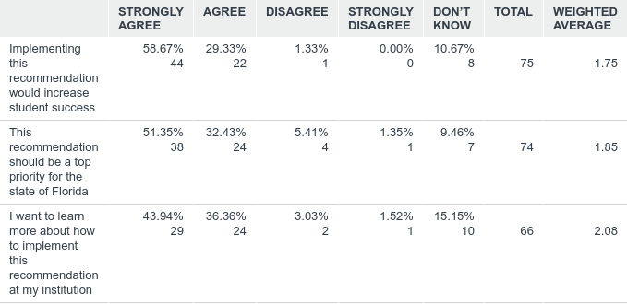
Q10: Recommendation 10: Increase the availability of advising resources and enlist the help of mathematics faculty, where appropriate.

Slide 39
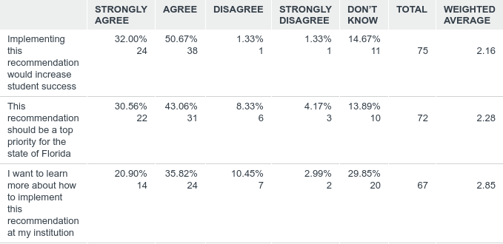
Q11: Recommendation 11: Ensure parents/guardians are informed of how to support and advise high school students into mathematics sequences aligned with the student’s college and career pathway.

Slide 40
Q&A

Slide 41
References
Advancing Mathematics Pathways for Student Success (AMPSS). (2017, March 6-7). National strategy for advancing mathematics pathways for student success. Summit on Mathematics Pathways. Indianapolis, IN.

